Slide 1
Kaizen Habit Tracker
Activity 2

Slide 2
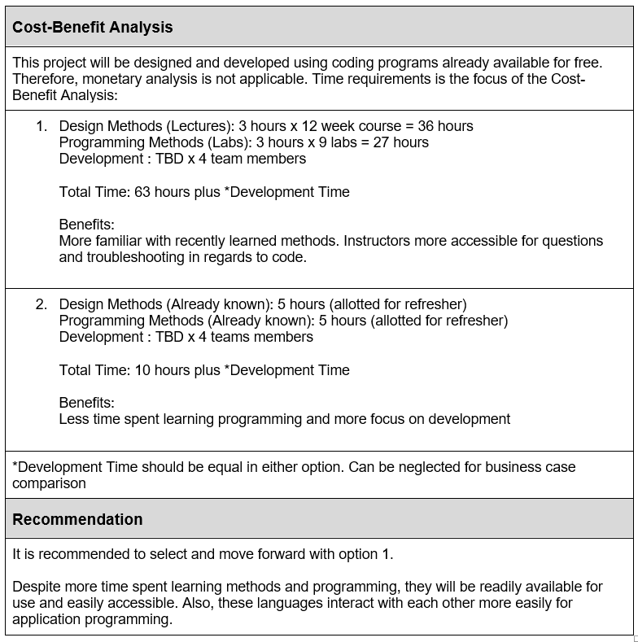
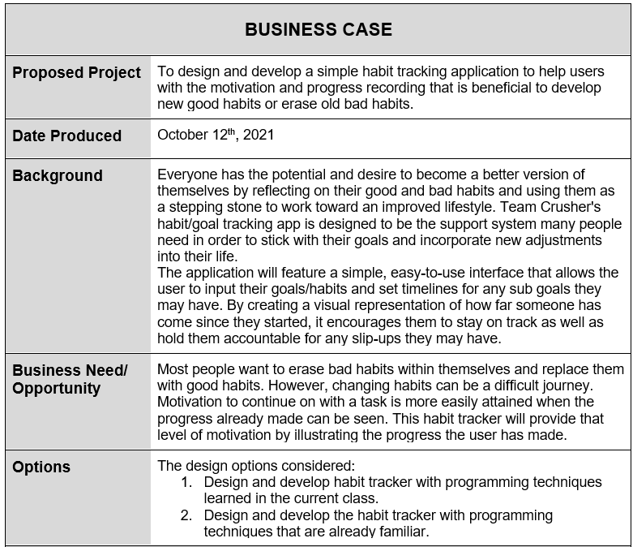
Business Case

Slide 3
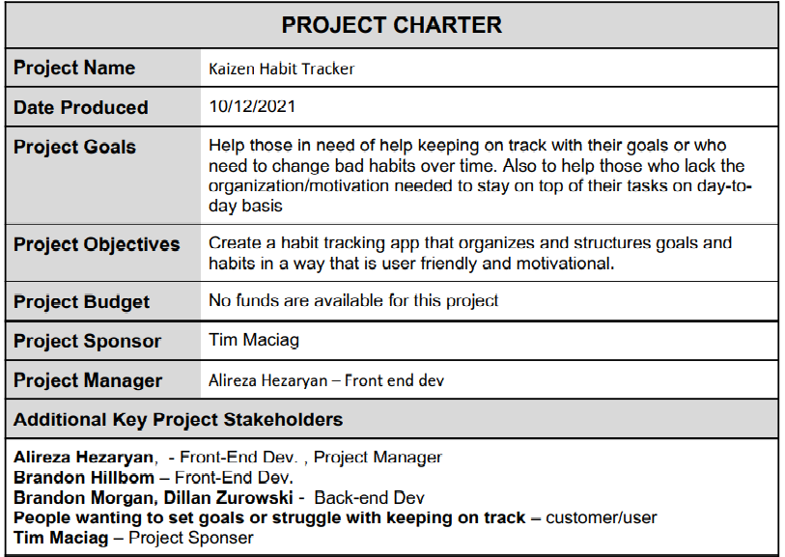
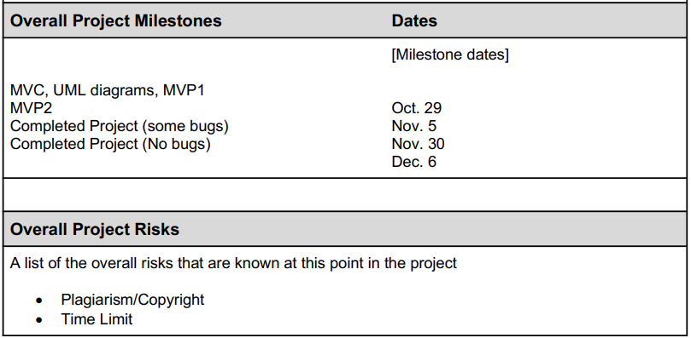
Project Charter
Notes:
Potential incompatibility between from end and back-end when both ends meet.
Lack of knowledge on either end as we are just learning material.

Slide 4
Stakeholder Register
STAKEHOLDER REGISTER
Project Name | Kaizen Habit Tracker App
Name | Project Role | Level of Power | Level of Interest | Level of Support
Tim Maciag | Project Sponsor | HIGH | LOW | Supportive
Users | Users/Customers | LOW | HIGH | Neutral
Alireza, Brandon H., Brandon M., DIllan | Project Team | HIGH | HIGH | Supportive

Slide 5
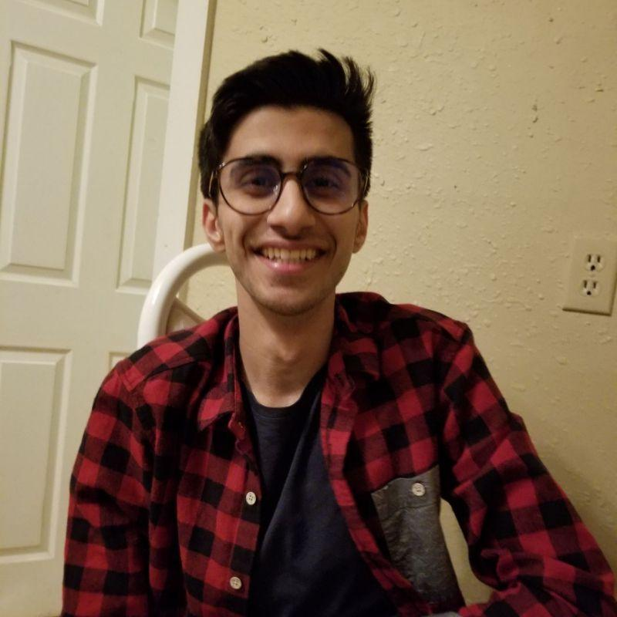
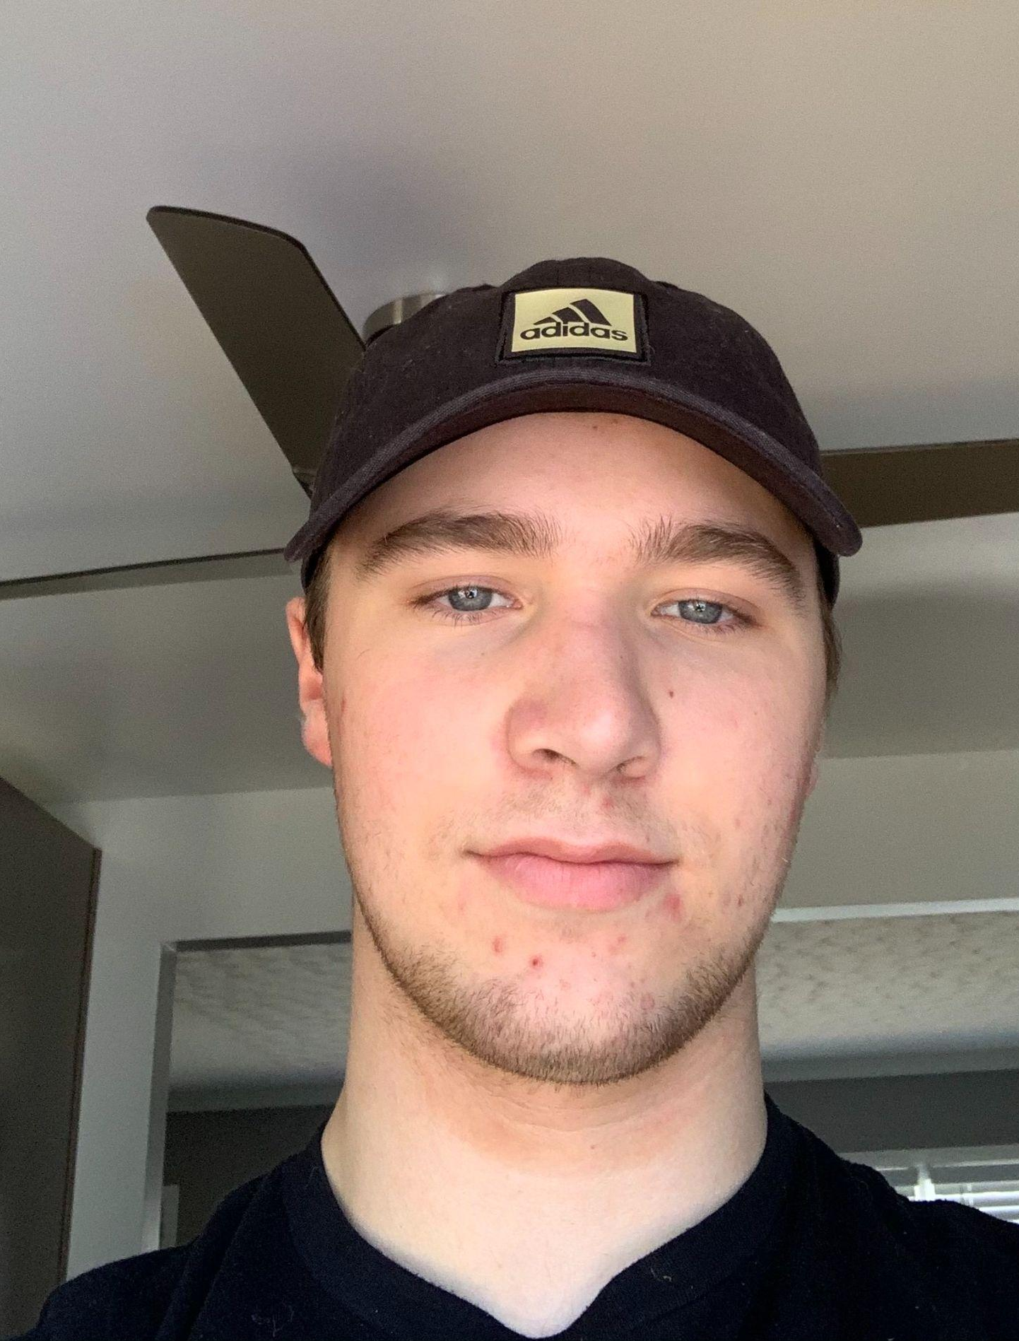
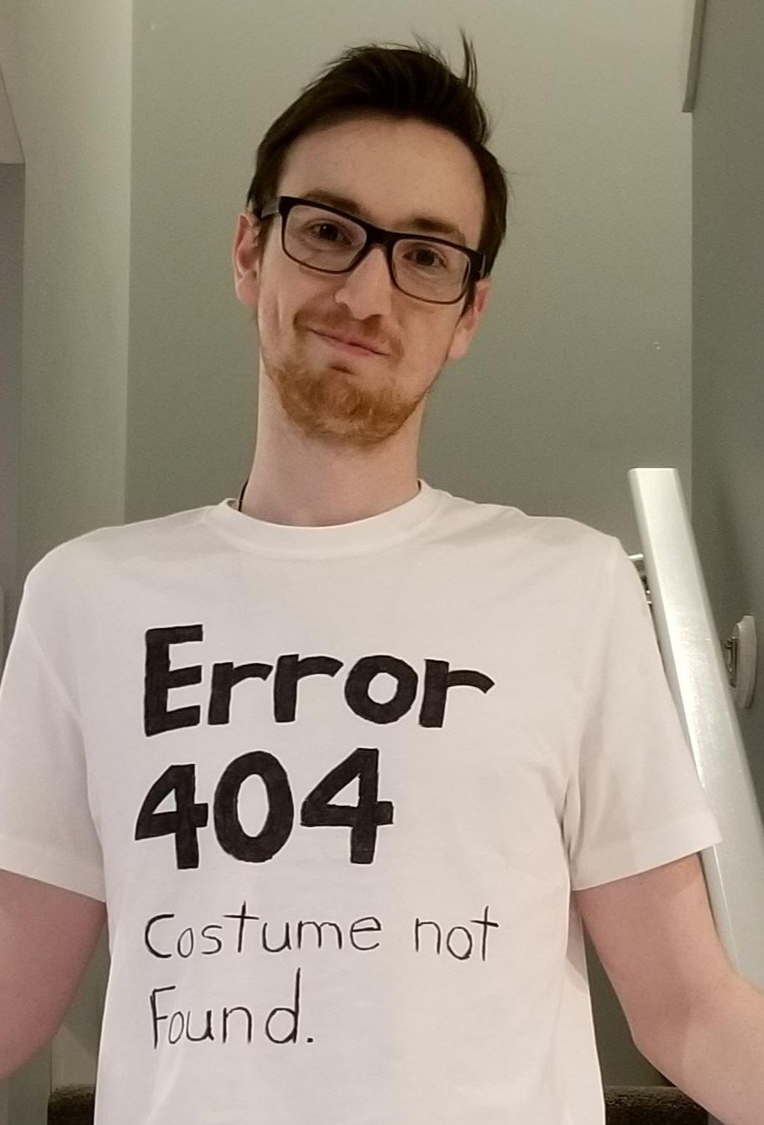
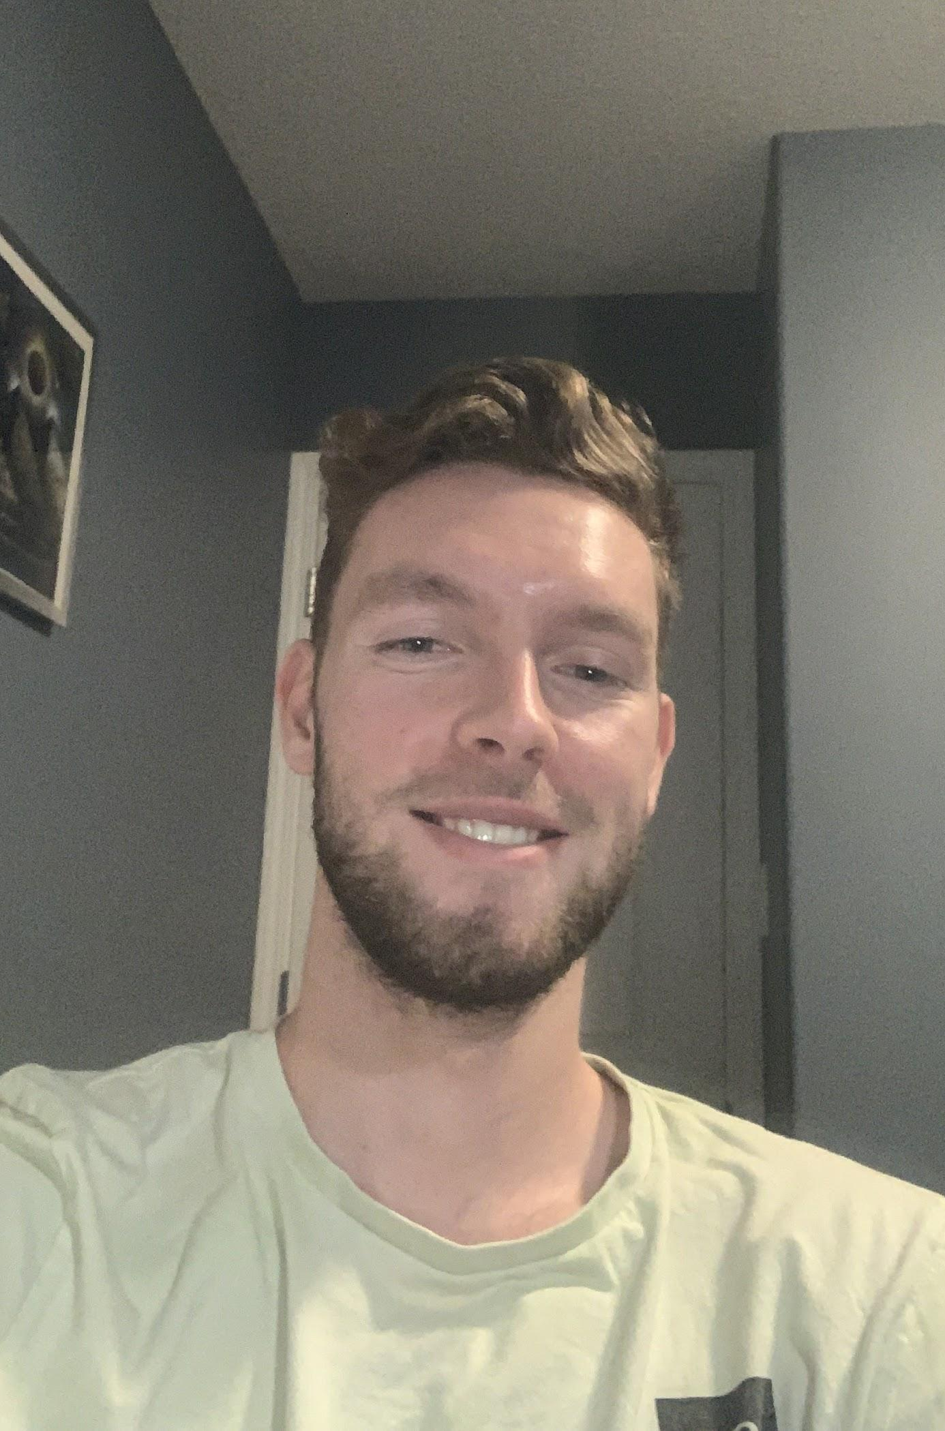
Project Roles and Responsibilities
Alireza Hezaryan
Brandon Hillbom
Front-end Developer & Project Manager
Front-end Developer
Brandon Morgan
Dillan Zurowski
Back-end Developer
Back-end Developer

Slide 6
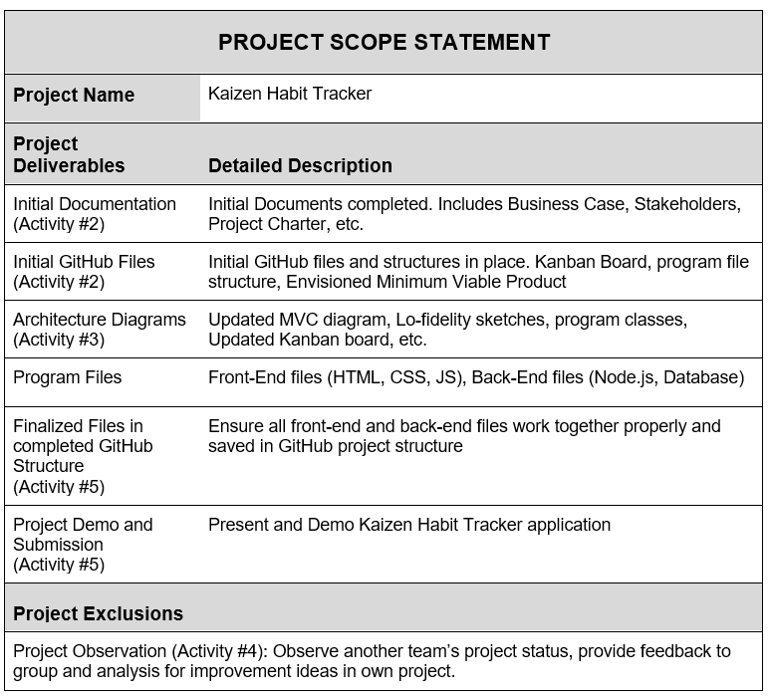
Project Scope

Slide 7
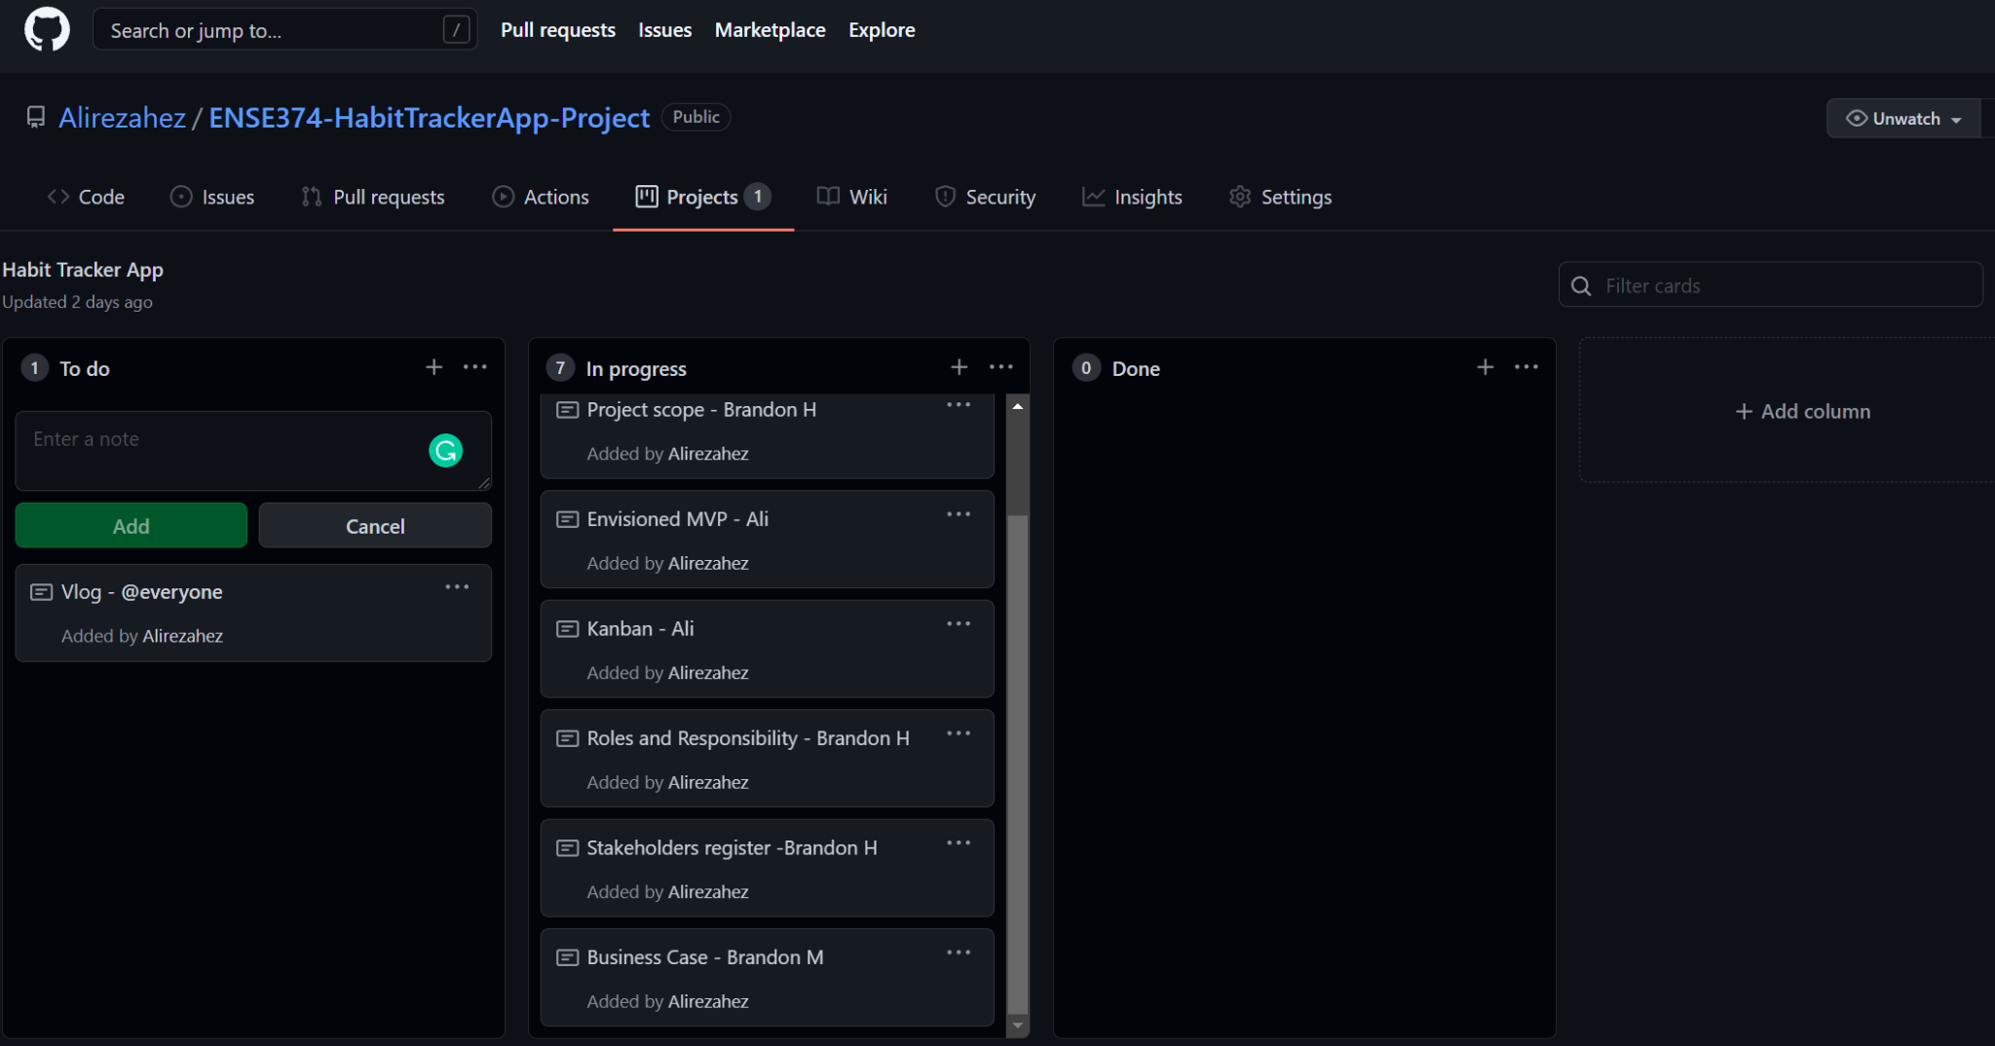
Kanban Board
Using Kanban board for assigning and managing tasks and blockers.

Slide 8
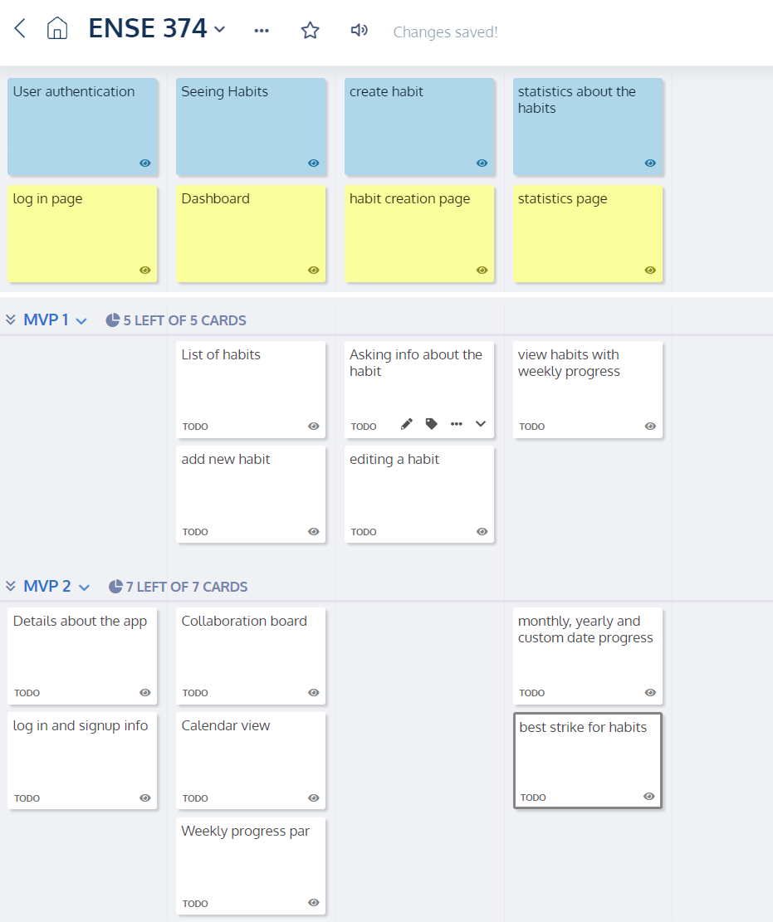
Envisioned MVPs
Using StoryOnBoard for managing MVPs

Slide 9
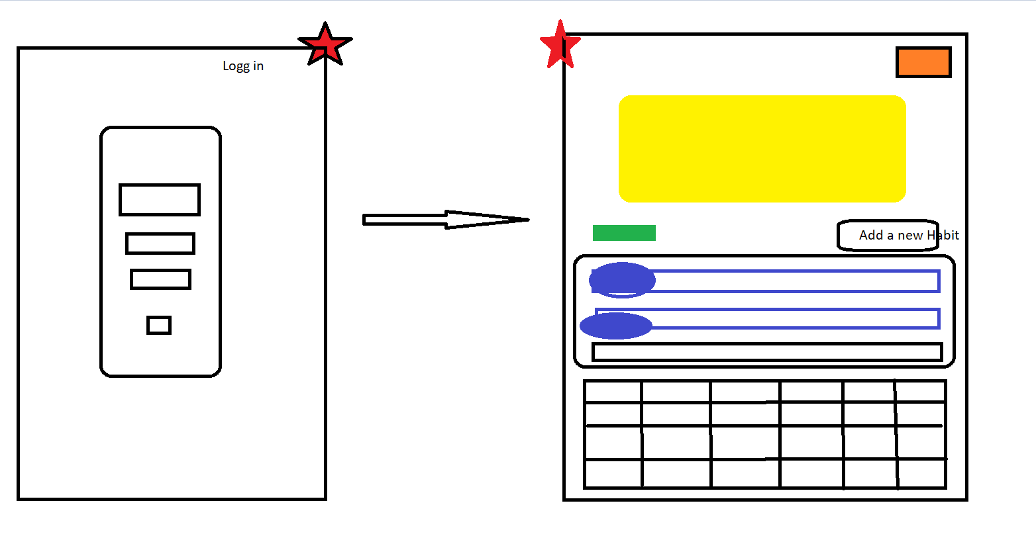
Further low fidelity designs
Working on low fidelity designs

